Slide 1
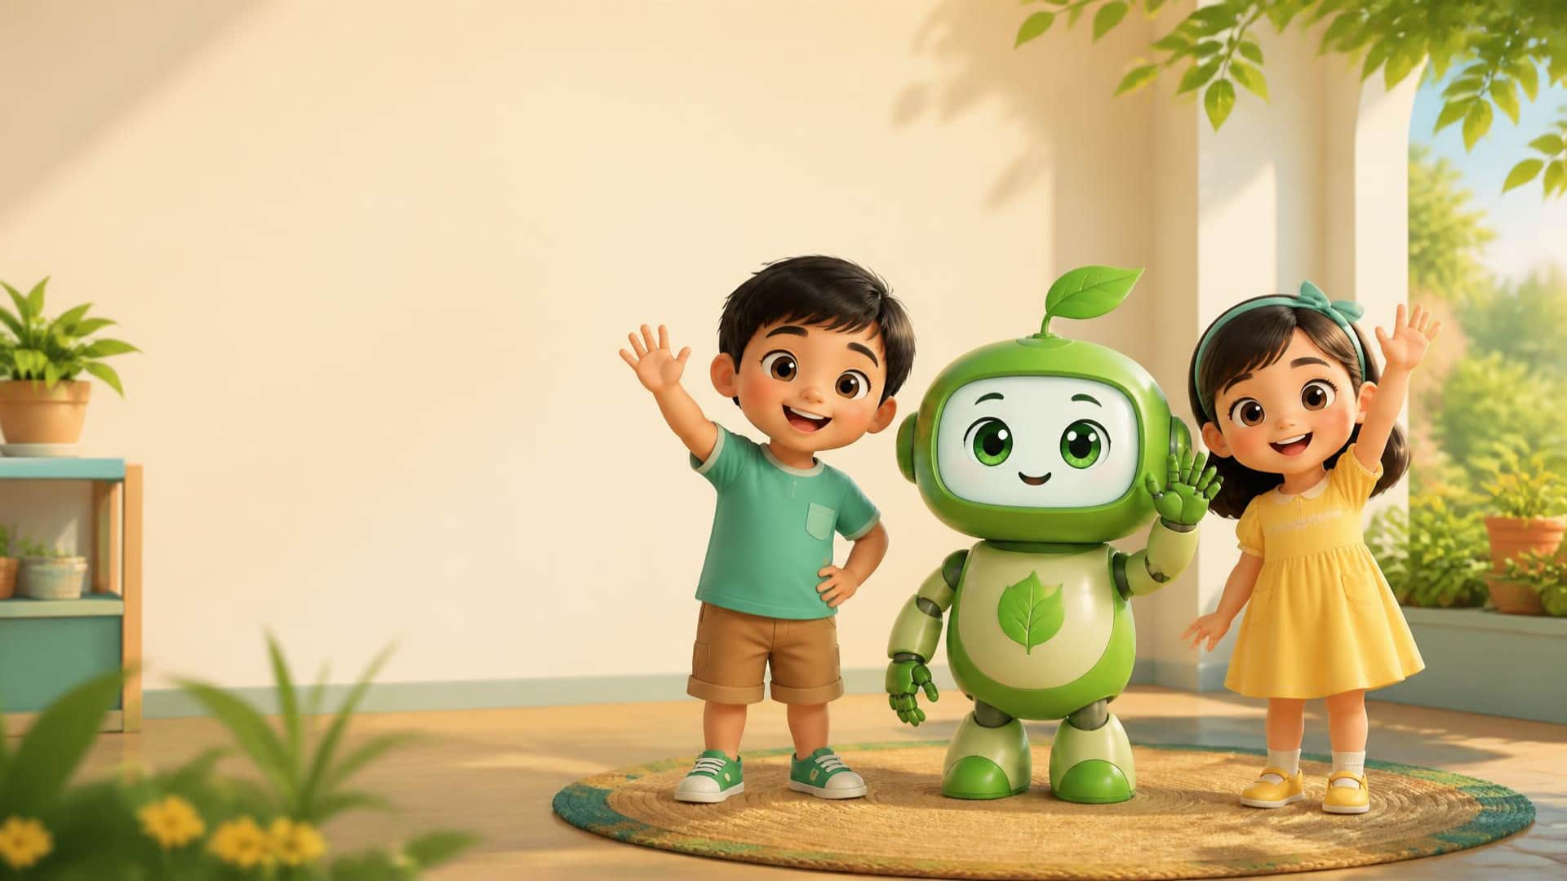

LESSON 7 - LETTER B IS FOR BIRD
1 / 13
Hello!
LITTLE SEEDS! MONTH 1
Notes:
Teacher script: Hello everyone! Welcome back! I am Teacher [Name]. Let's say hello to our friends!

Slide 2
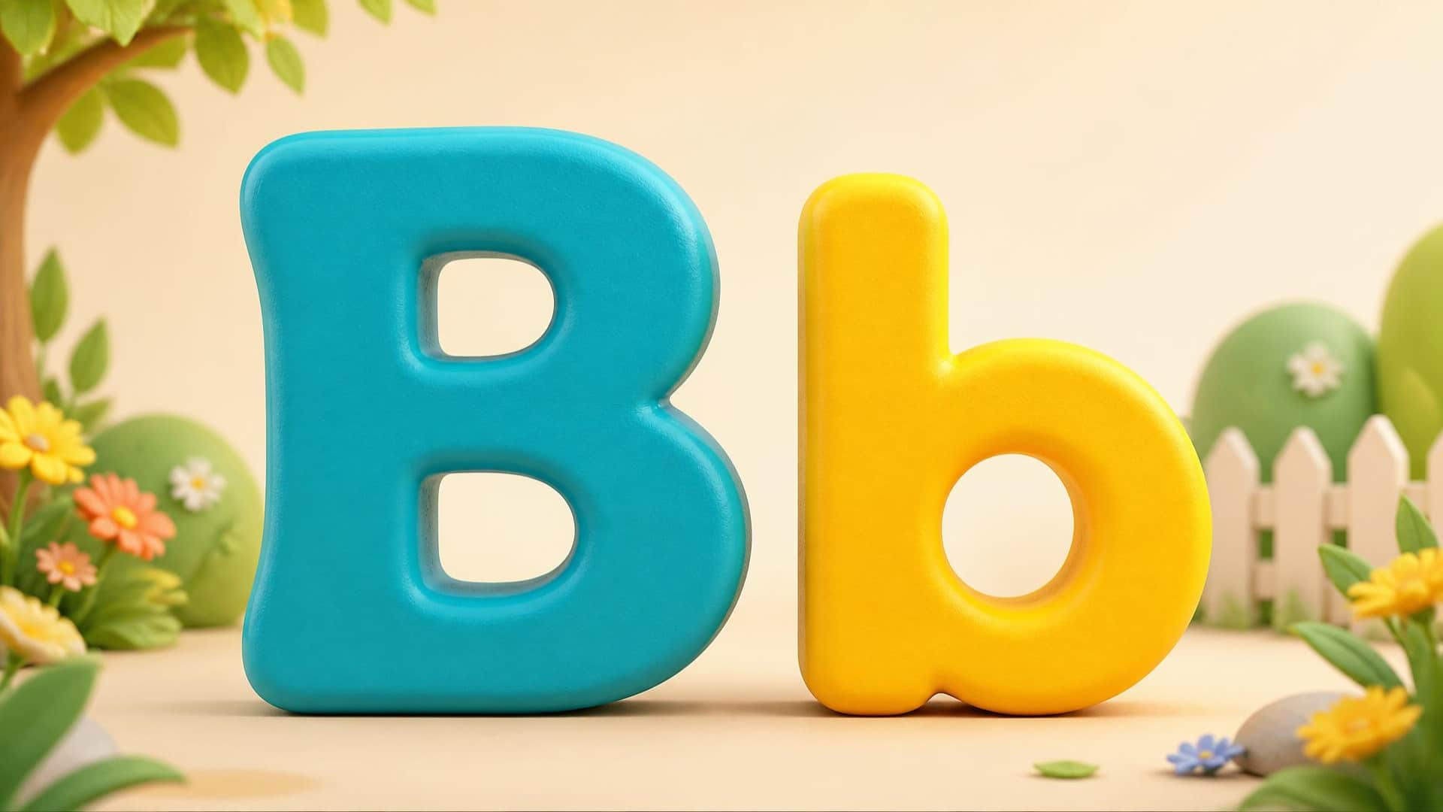
Lesson 7 – Letter B is for Bird
2 / 13
Bb
LITTLE SEEDS! MONTH 1
Notes:
Teacher script: Today we have a new letter! Listen: B. Say: B! [Cup ear]

Slide 3
Lesson 7 – Letter B is for Bird
3 / 13
/b/
LITTLE SEEDS! MONTH 1
Notes:
Teacher script: Watch my mouth. [Point to lips] /b/, /b/, /b/. Press your lips together. Can you say /b/? [Wait for response]

Slide 4
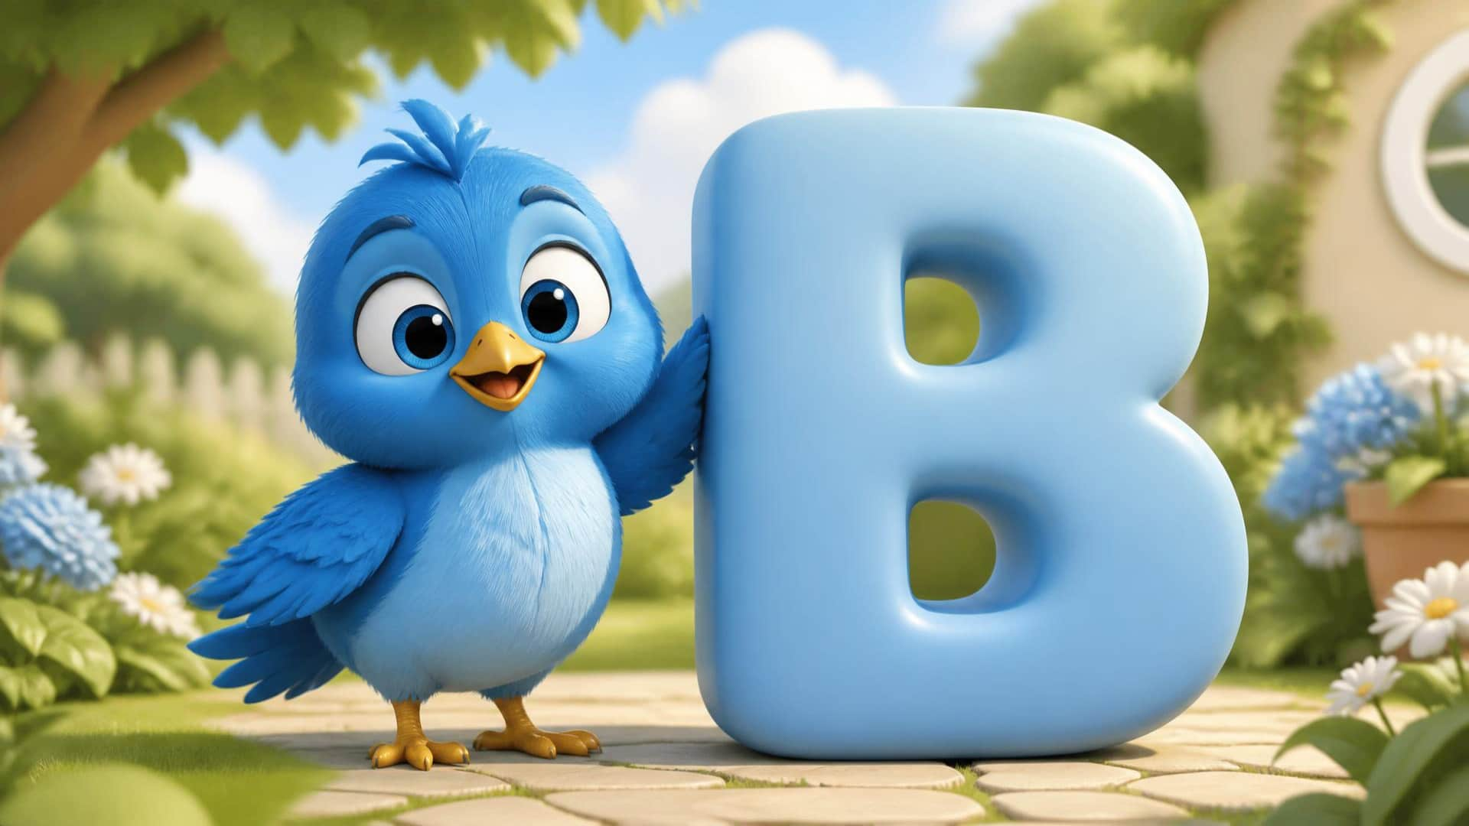
Lesson 7 – Letter B is for Bird
4 / 13
B is for Bird.
LITTLE SEEDS! MONTH 1
Notes:
Teacher script: B is for Bird! Listen: /b/ - /b/ - Bird! Say it with me: /b/ - /b/ - Bird!

Slide 5
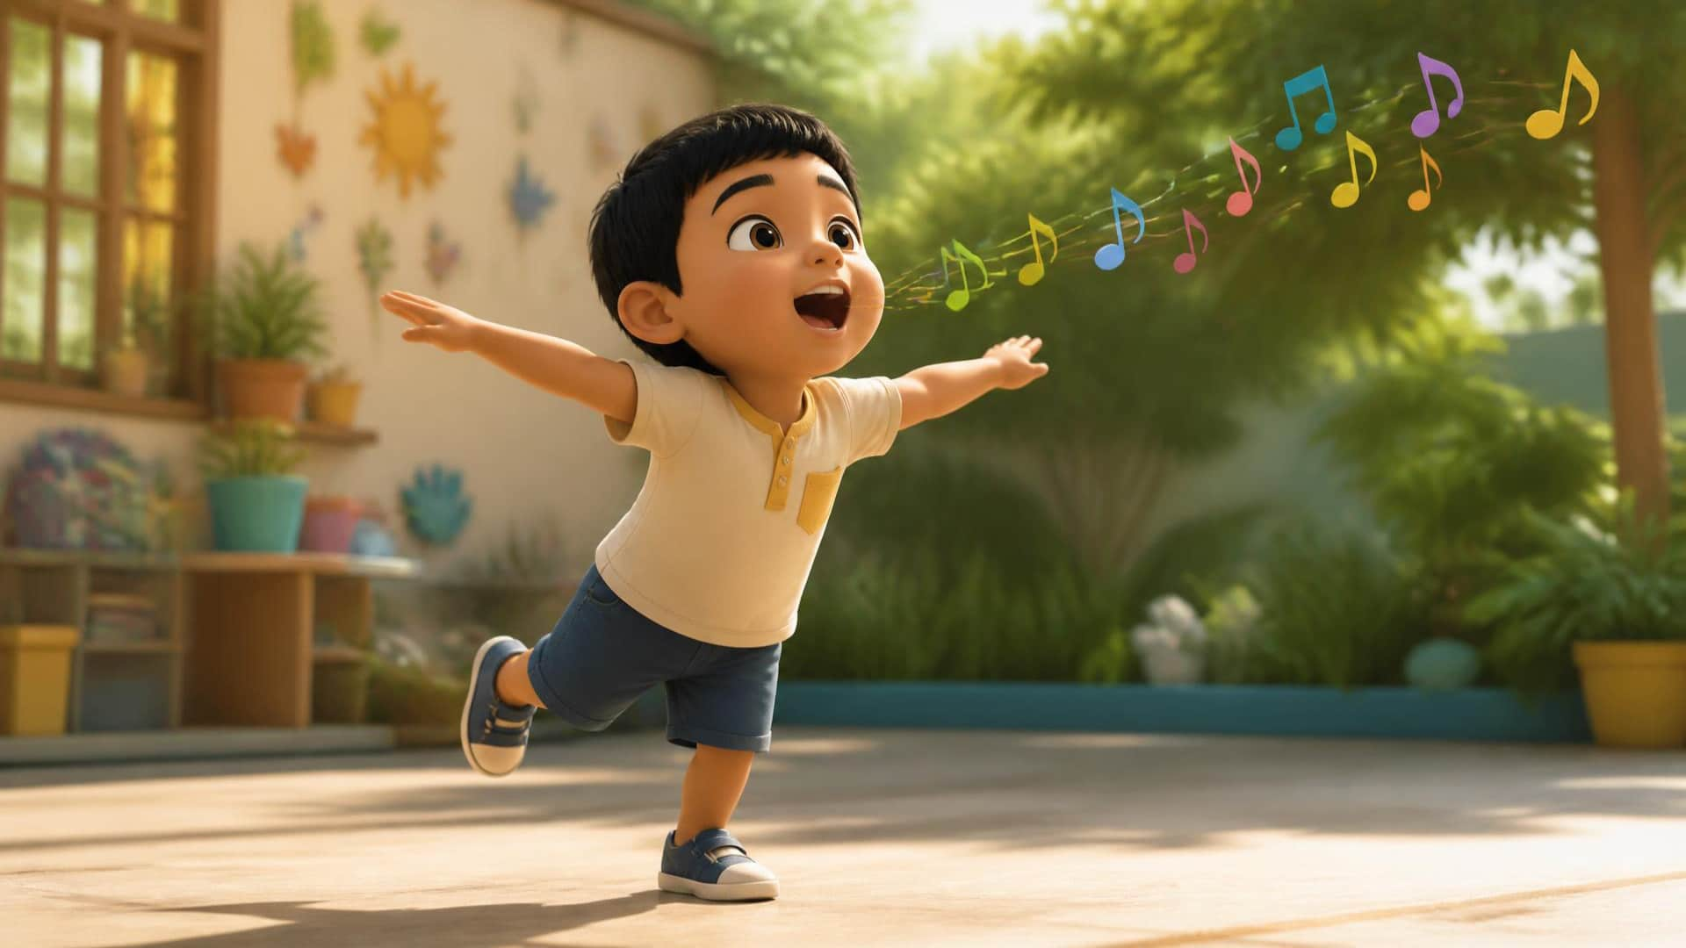
Lesson 7 – Letter B is for Bird
5 / 13
Tweet, tweet!
LITTLE SEEDS! MONTH 1
Notes:
Teacher script: Let's fly like a bird! [Flap arms] Now let's sing! Tweet, tweet! /b/ - /b/ - Bird!

Slide 6
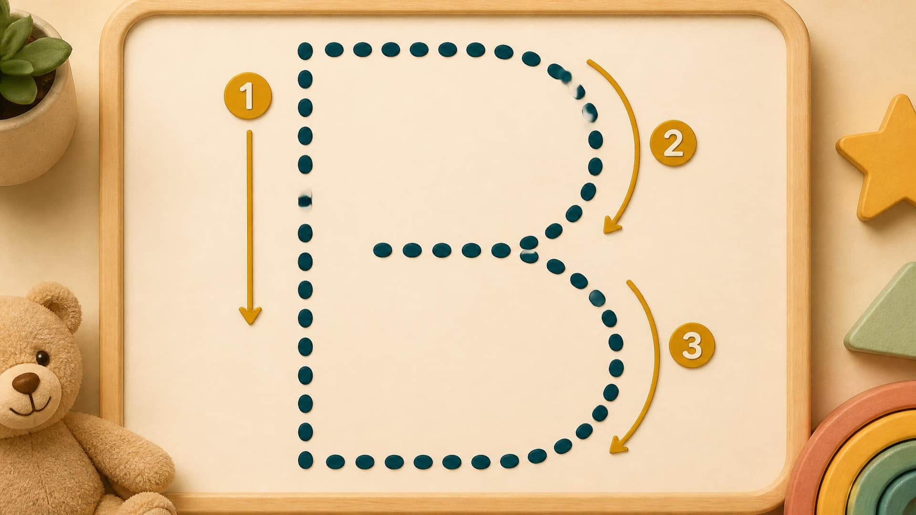
Lesson 7 – Letter B is for Bird
6 / 13
Draw B.
LITTLE SEEDS! MONTH 1
Notes:
Teacher script: Magic finger! Let's write big B. Line straight down. [Trace down] Now around, and around! [Make two curves] You do it!

Slide 7
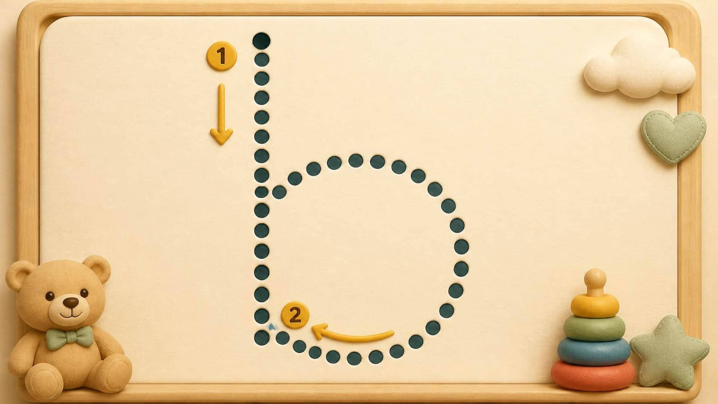
Lesson 7 – Letter B is for Bird
7 / 13
Draw b.
LITTLE SEEDS! MONTH 1
Notes:
Teacher script: Now small b! Line straight down. [Trace down] And one circle around! [Make a bottom curve] Good job!

Slide 8
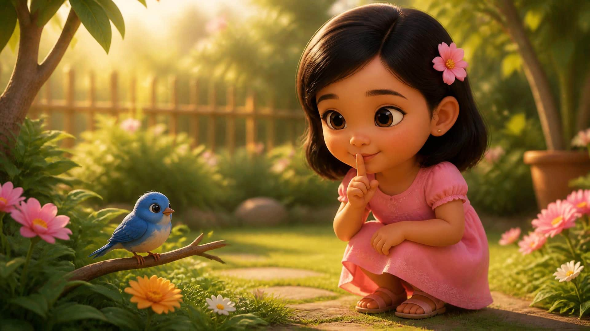
Lesson 7 – Letter B is for Bird
8 / 13
Be quiet and gentle.
LITTLE SEEDS! MONTH 1
Notes:
Teacher script: Do we yell at the bird? No! The bird will fly away. We stay quiet. Shh. [Finger to lips] We use gentle eyes to look.

Slide 9

Lesson 7 – Letter B is for Bird
9 / 13
God made the birds.
LITTLE SEEDS! MONTH 1
Notes:
Teacher script: Who made the birds to fly high? God made the birds! God gave them wings. [Flap arms once]

Slide 10
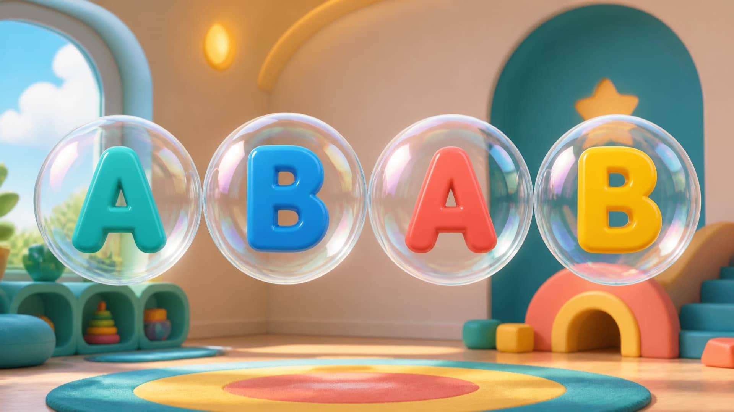
Lesson 7 – Letter B is for Bird
10 / 13
Pop the B!
LITTLE SEEDS! MONTH 1
Notes:
Teacher script: Pop the bubbles! Only pop the letter B! Touch B! [Wait for taps] Pop! Pop! Great job!

Slide 11
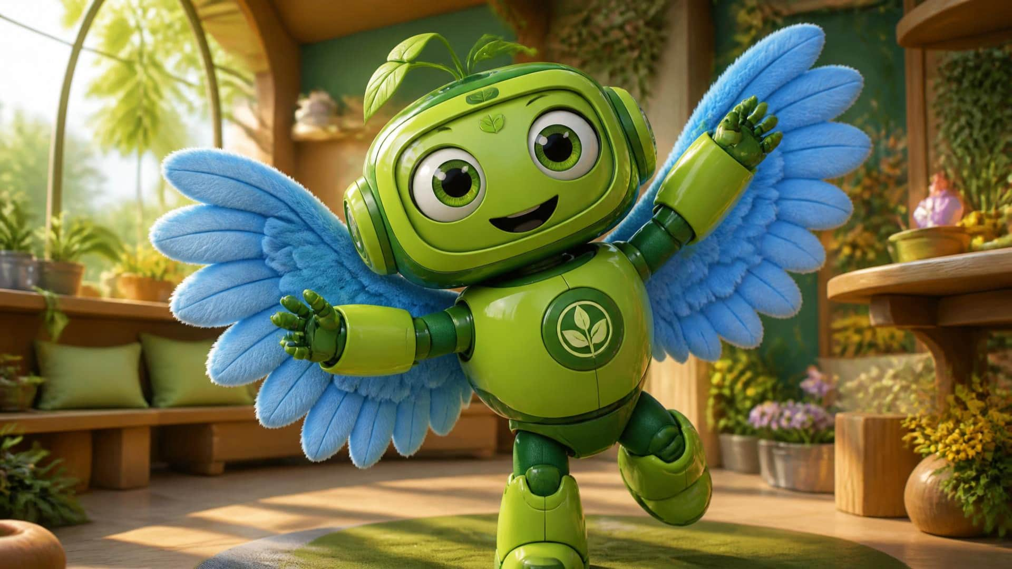
Lesson 7 – Letter B is for Bird
11 / 13
Your turn!
LITTLE SEEDS! MONTH 1
Notes:
Teacher script: Stand up! Show me your best bird! Fly around your room! /b/ /b/ Bird! [Watch and laugh with the student]

Slide 12
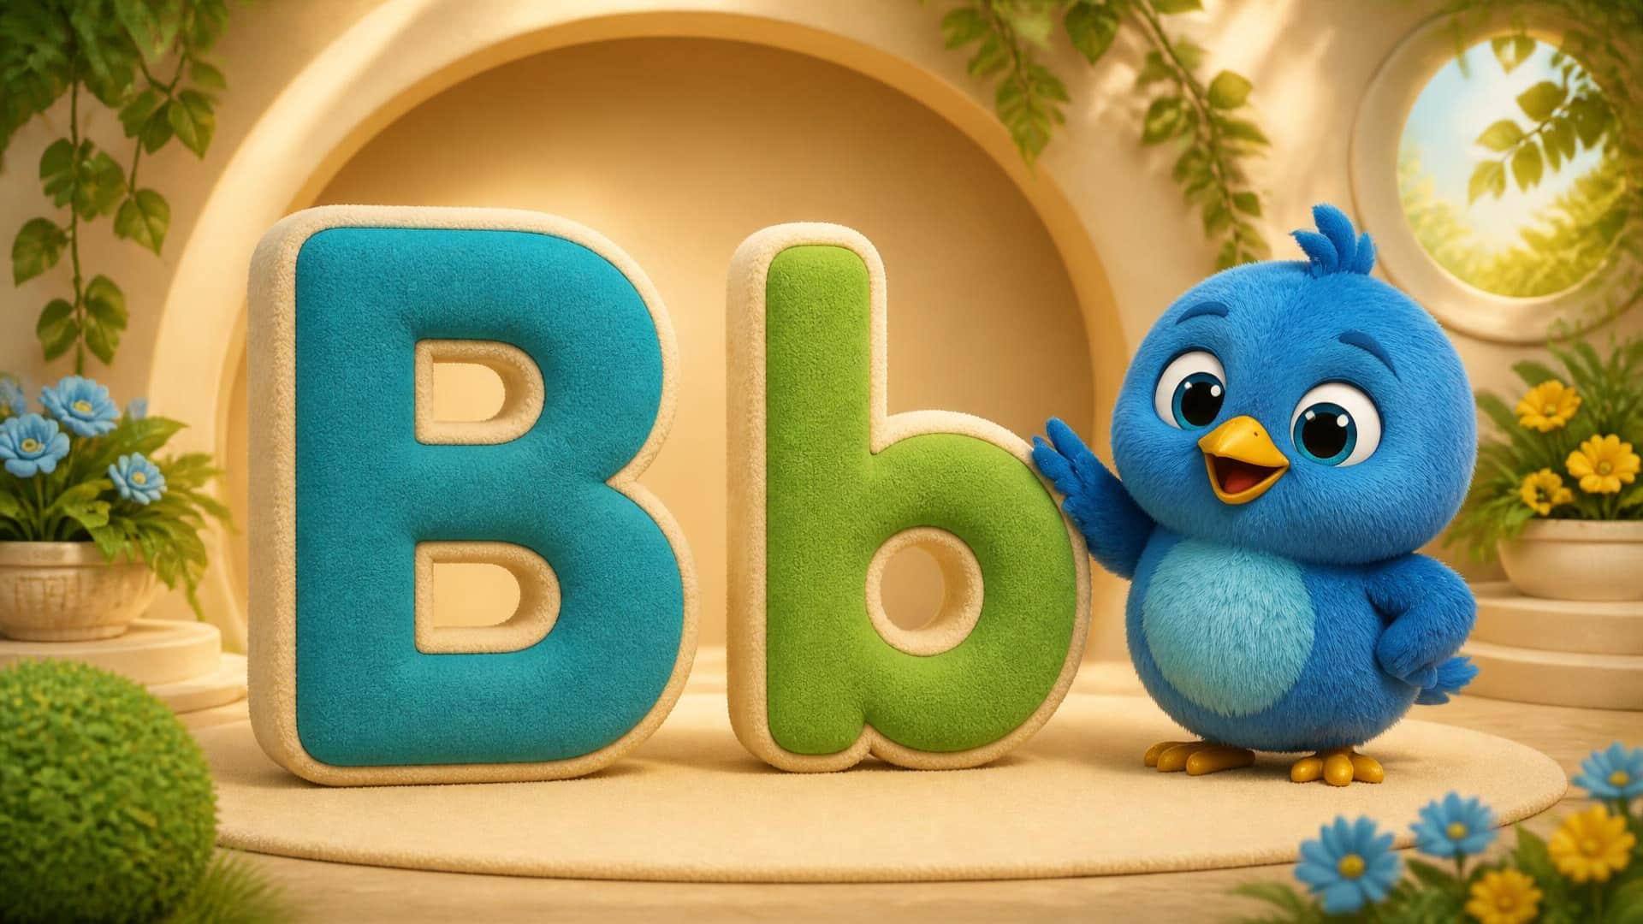
Lesson 7 – Letter B is for Bird
12 / 13
Bb. Bird.
LITTLE SEEDS! MONTH 1
Notes:
Teacher script: Let's practice one more time. Say: B! Say: /b/ - /b/ - Bird! Excellent!

Slide 13
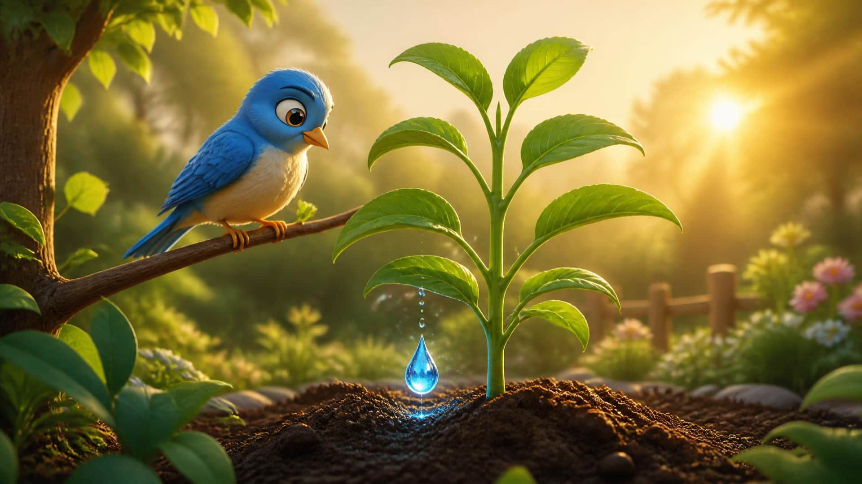
Lesson 7 – Letter B is for Bird
13 / 13
Goodbye!
LITTLE SEEDS! MONTH 1
Notes:
Teacher script: Another Eco-Drop! The bird is happy in your garden. Great job today! Goodbye! [Wave]

